Slide 1
Algorithms for Analysis of Genomic Sequence Data
Alexey V. Zimin
JHU BME 580.417/707

Slide 2
Week 1
Alexey V. Zimin
JHU BME 580.417.707

Slide 3
Introduction to the course
Professor: Alexey Zimin, https://ccb.jhu.edu/people/alekseyz/
Times: MWF, 8:00am – 8:50am
Location: Hodson 203
Office hours and location: Wyman Park building, second floor, S237, Wednesdays 4pm-5pm.
Textbook: None, all lecture slides will be made available online
Attendance policy: attendance is mandatory, no video/audio lecture recordings will be made available online. Lecture slides will be available online.
GRADING POLICY: Six laboratory assignments are worth 14% each. The in-class presentation is worth 16%.
This is a new course. The pace of the course and topics covered may be adjusted as we go through the semester.

Slide 4
More on the grades
Grades will be derived from six lab assignments, and an in-class presentation
Lab assignments will include writing a code to accomplish certain task and may include additional task to plot outputs (depending on the assignment)
You can write code in python, all code submissions will be handled and graded by GradeScope
You can use AI (e.g. ChatGPT or MS Copilot) to help you with writing the code, however, the you must understand that an AI will always provide very similar code when prompted. If several students submit very similar code, this will be flagged in GradeScope, and may become grounds for investigation for cheating

Slide 5
Reading list and presentations
I will share a Google Sheet listing a set of papers on genome assembly/annotation
Each student can choose a paper they will read (you are welcome to read more than one).
Each student will them prepare a 10-minute presentation on an aspect of a paper related to what we studied in class.
The presentations will be scheduled during the last three weeks of the course, and they are worth 16% of the grade

Slide 6
Concepts we will learn
Basics DNA/RNA sequencing
Alignment of DNA/RNA/AA sequences, suffix arrays, BW transform, Smith-Waterman alignment
Assembly methods of DNA/RNA sequencing data and corresponding data structures: k-mer and overlap graphs
Evaluation of assemblies
Making sense of the genomic sequence -- introduction to genome annotation

Slide 7
Computing facility
I designed most of the lab assignments to be light on the data/computing, a laptop with 8-16Gb of RAM and a few Gb of available disk space will be enough for the labs
You can use campus computing facilities that are available to you
Talk to me after class if you need computer access

Slide 8
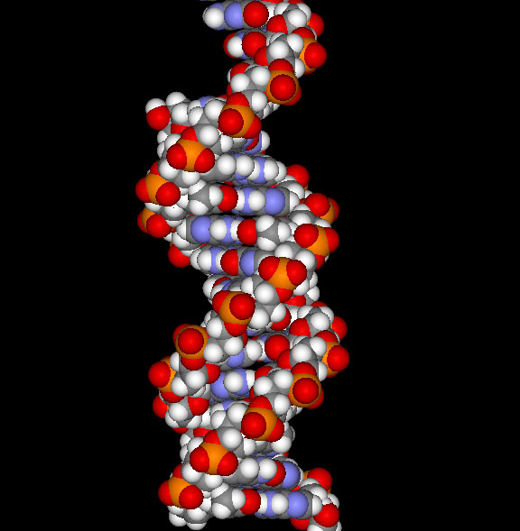
What is DNA?
Most cells in all living beings have a DNA molecule in their nucleus
DNA abbreviates DeoxyriboNucleic Acid
Determines the structure, function, and behavior of the cell
Linear, double-stranded, helical molecule.
Consists of four types of nucleotides (bases):
adenine (A)
thymine (T)
guanine (G)
cytosine (C)

Slide 9
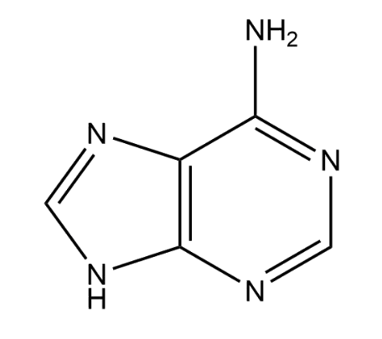
Nucleotide: Phosphate, Base and Pentose sugar
OH
Pentose sugar (Ribose)
O
P
O
OH
C(5’)
O
OH
C(4’)
C(1’)
OH
Phosphate
Base (A)
C(3’)
C(2’)
OH
OH

Slide 10
Nucleotide: Phosphate, Base and Pentose sugar
OH
DeoxyRibose
O
P
O
OH
C(5’)
O
OH
C(4’)
C(1’)
OH
Phosphate
Base (A)
C(3’)
C(2’)
OH

Slide 11
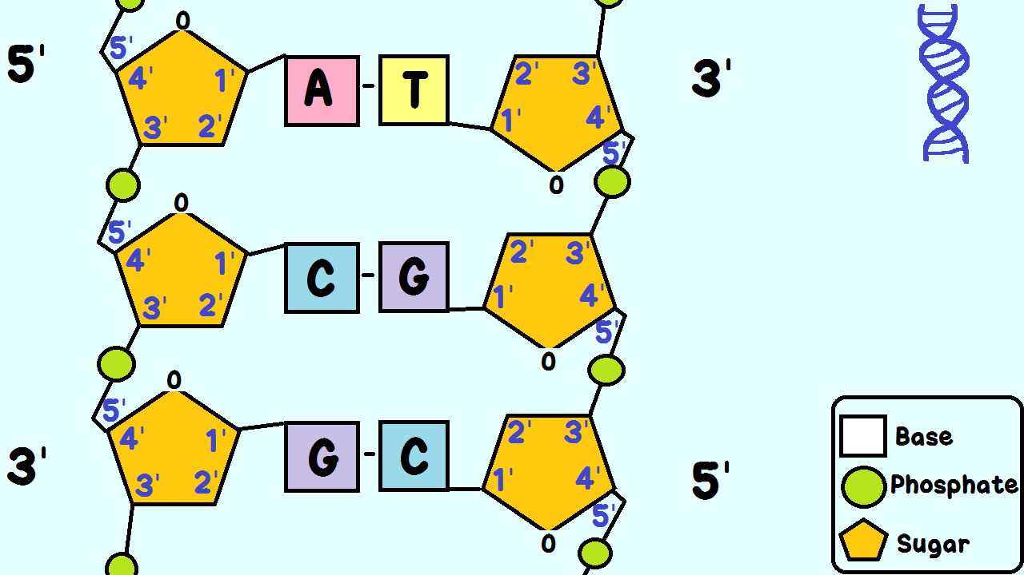
DNA replication
DNA polymerase reads from 3’ end to 5’ end and synthesizes (writes) from 5’ to 3’ direction (Image by GiGa Group)

Slide 12
Complementary strands
DNA is double-stranded : 5’ forward strand direction -> AGATAGACATAGACATAGACAGATACACTCGATCG ||||||||||||||||||||||||||||||||||| TCTATCTGTATCTGTATCTGTCTATGTGAGCTAGC <-5’ reverse strand direction
These two sequences are the SAME: AGATAGACATAGACATAGACAGATACACTCGATCG or CGATCGAGTGTATCTGTCTATGTCTATGTCTATCT

Slide 13
DNA extraction
Lysis: This step breaks open cells to release DNA into solution. Lysis can be achieved through physical, chemical, or enzymatic methods.
Separation: After lysis, the DNA needs to be separated from cellular debris, proteins, and other macromolecules. This can be done through methods like salting out, precipitation with alcohol, or magnetic bead separation.
Purification: Once separated, the DNA is further purified to remove any remaining contaminants. This can involve techniques like silica-based column purification, or washing the DNA pellet with ethanol.
Concentration: Finally, the DNA is concentrated by removing the remaining liquid through methods like vacuum centrifugation or lyophilization.

Slide 14
DNA Extraction -Video
Video demonstration of strawberry DNA extraction
DIY DNA Extraction!

Slide 15
Library preparation
Fragmentation: DNA is fragmented by mechanical or chemical (restriction enzyme) means
DNA end repair: ends are repaired by incorporating missing nucleotides AGATAGACATAGACATAGACAGATAC ||||||||||||||||||||||||||||||||||| TGTATCTGTATCTGTCTATGTGAGCTAGC
Size selection: fragments of target size are pulled out:
Gel electrophoresis
Magnetic beads

Slide 16
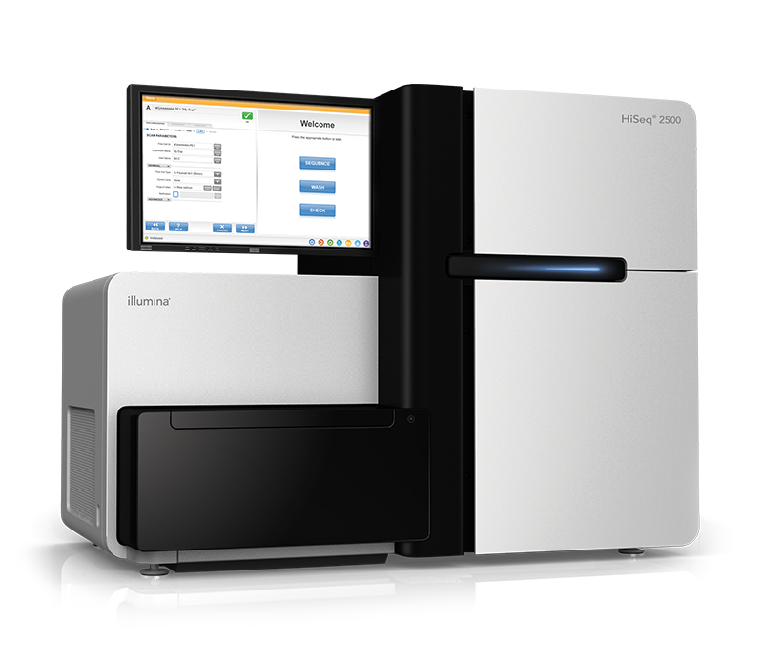
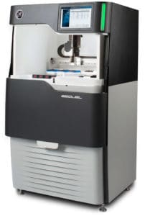
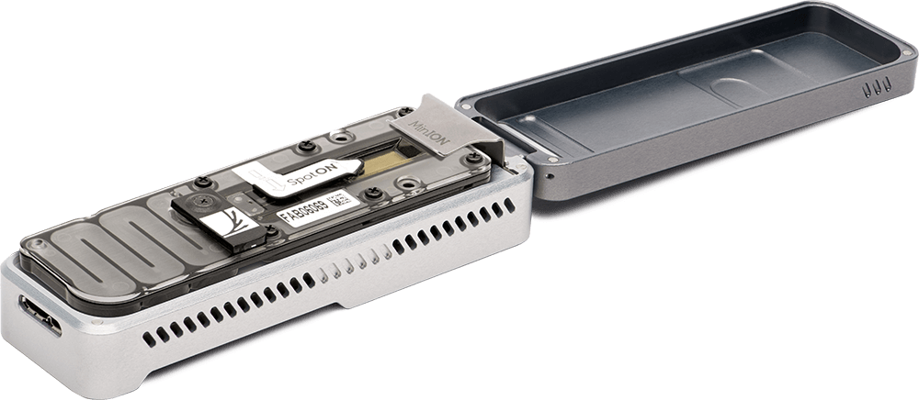
DNA sequencing overview
Multiple copies of DNA
Fragments of
150 - >500,000 bases
Read the Sequences
Extract, Shred &
(Size select)

Slide 17
DNA sequencing data: (pairs of) reads
Sequencing machines output letters of DNA and estimated quality scores
Two types of data:
Reads
Pairs of reads
A read is a sequence of letters read from a forward or reverse strand
Letters (bases) typically have quality scores

Slide 18
Types of sequencing reads
Single-end reads: PacBio HiFi or Oxford Nanopore: 5’ direction -> AGATAGACATAGACATAGACAGATACACTCGATCG TCTATCTGTATCTGTATCTGTCTATGTGAGCTAGC <-5’ reverse strand direction
You get: AGATAGACATAGACATAGACAGATACACTCGATCG or CGATCGAGTGTATCTGTCTATGTCTATGTCTATCT

Slide 19
Types of sequencing reads
Paired-end reads: Illumina 5’ direction -> AGATAGACATAGACATAGACAGATACACTCGATCG TCTATCTGTATCTGTATCTGTCTATGTGAGCTAGC <-5’ reverse strand direction
You get: AGATAGACATA and CGATCGAGTGT

Slide 20
Current DNA sequencing technologies
Short Reads: Illumina
☺ Cheap: as low as $1K for de novo human genome
☺ Accurate: ~1% error rate
☹ Only 150 to 300 bp reads, paired ends of 300-800bp fragments
Long Reads: Oxford Nanopore and PacBio HiFi
☺ Inexpensive: $2-5k for a de novo human genome
☺ We get on average long 5-500Kbp reads
☹ High error rate: ~3-7% for ONT, <1% error rate for HiFi

